Slide 1
Basic of Python
Girish S Kumar

Slide 2
Variables in python
Variables are container of data
Python Variables can store , number, characters, strings, descriptors etc in variables
Unlike is C/C++ there are not sperate data types for variable in python. Python does not distinguish between Integer character variables
There is not need to declare variable prior to usage
A variable is created at the time of first initialization
In the previous example when we say
X = 10
Y = 20
The moment when interpreter execute the statement x = 10 a integer variable is created. Same with y too.

Slide 3
Rules for naming Variable
In python the rules of naming identifiers are applies to variables too
• The first character of the identifier must be a letter of the alphabet (uppercase ASCII or lowercase ASCII or Unicode character) or an underscore ( _ ).
• The rest of the identifier name can consist of letters (uppercase ASCII or lowercase ASCII or Unicode character), underscores ( _ ) or digits (0-9).
Identifier names are case-sensitive. For example, myname and myName are not the same. Note the lowercase n in the former and the uppercase N in the latter.

Slide 4
Concept of Physical and Logical lines
A physical line is what you see when you write the program.
A logical line is what Python sees as a single statement.
Python implicitly assumes that each physical line corresponds to a logical line.
Length = 10
print Length
Logical Line and Physical Line are the same
Length = 10 ; print Length
Two Logical Line in a Physical Line
Separate by a semi colon

Slide 5
A logical line can be broken into two physical lines when it does not fit into one line it is done with \ character
Example
myStr = 'This is actually a string. \
The string is continued in the next line.'
print s
Output of the this program will be:
This is actually a string. The string is continued in the next line.

Slide 6
Indentation in Python
Indentation is a very IMPORTANT CONCEPT IN PYTHON
White spaces which are inserted at the beginning of a logical line is called indentation. White spaces can be blank space or tab.
print “Hello World” --→ Has not indentation
print “Hello World” -→ has two white spaces inserted hence it is indentated
Python uses these indentation to identify blocks of statements.

Slide 7
To give you an example of how indentation is important.
print “Hello World”
print “Hello World”
Will print Hello World twice in the screen
print “Hello World”
print “Hello World”
pi@arjuna:~ $ !p
python indent.py
File "indent.py", line 2
print "Hello world"
^
IndentationError: unexpected indent
pi@arjuna:~ $
Indentation should be used only where ever it is needed

Slide 8
Indentation should be used only where ever it is needed. There are many places we have to use indentation (must). So indentation is very critical aspect in Python
This will be discussed in the subsequent section

Slide 9
Input output operations with console in python

Slide 10
Output : Printing on Console
age = 10
print ‘My age is’, age
print ‘I am’, age , ‘years old’
pi@arjuna:~ $ !p
python indent.py
My age is 10
I am 10 years old
pi@arjuna:~ $
s = ‘’’ This is a multi-line string.
This is the second line.’’’!
print s
pi@arjuna:~ $ python try.py
This is a multi-line string.
This is the second line.
pi@arjuna:~ $

Slide 11
Input : Reading on Console
length= raw_input('Enter an integer : ')
print length
pi@arjuna:~ $ python input.py
Enter an integer : 45
45
pi@arjuna:~ $
In the above example raw_input() return the entered value as character string and not as a number, hence we cannot do any arithmetic operation on the variable length , let us demonstrate this in the next section

Slide 12
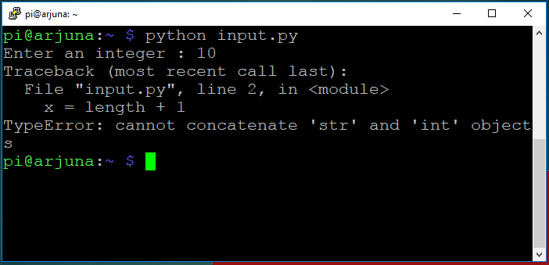
Let us make a small modification
length= raw_input('Enter an integer : ')
x = length + 1
print length
print x
we NOT are able to do arithmetic operations on the variable length

Slide 13
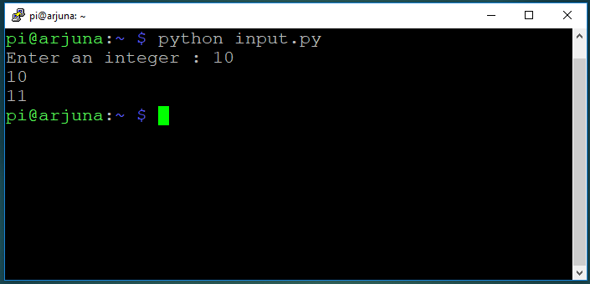
Let us make a small change to fix this issue
length= int(raw_input('Enter an integer : '))
x = length + 1
print length
print x
Now we are able to do arithmetic operations on the variable length

Slide 14
Strings in Python Python is famous for its libraries for handling strings. One of the real value adds of python is its ability to process strings

Slide 15
What are strings
A string is a sequence of characters a sentence can be treated as string
Eg “hello 123” is string
A set of characters enclosed between a single quote or double quote
Eg:
“Hello how are you”
and
‘Hello how are you’
Means the same …………..

Slide 16
Python allows you specify string across multiple Physical lines
Let us say you want to have a large sentence of paragraph as a single string in python. Normally when you type such a long sentence it will be spread across multiple physical lines in your source code.
To support large string which are spread across multiple lines we can use triple Quotes, Example is
‘’’ Python is an excelled programming language this was first developed as Hobby by a Dutch programmer by name Guido van Rossum. His aim was to develop a programming language for everyone’’’ (Using Single Quote)
The same can be written as (Using double quotes)
“”” Python is an excelled programming language this was first developed as Hobby by a Dutch programmer by name Guido van Rossum. His aim was to develop a programming language for everyone “””

Slide 17
Declaring string
There is no particular data type reserved for string in python the moment when a variable is initialized the type is also allocated.
myName = “Vimal Kumar”
A string variable by name myName is created and initialized

Slide 18
Formatting a string
It is not always possible to create string with all the data at the beginning. Let us say we want to create a string with name and age of a person as follows
Sentence = “Student Kumar is 20 years old”
In this case the name “Kumar”and his age “20”come from a data file or from a variable. How do we create and print string like this.
This is the string API in python is used. Python strings has a in build API called format() the way it is used is
name = “Kumar”
age = 20
Sentence = “Student {0} is {1} years old”.format(name,age)
Here name is the zero-th argument and age is the first argument, each argument is substituted in the string as per the format specification. Format specification is mentioned using {} brackets

Slide 19
In case the argument numbers are ignored in the format specifier the default arguments will be supplied in the order
name = "Kumar"
age = 20
# with Argument in format specifiers
sentence = "Student {0} is {1} years old".format(name,age)
print sentence
name = "Anil"
age = 30
# without Argument in format specifiers
sentence = "Student {} is {} years old".format(name,age)
print sentence
# Argument in format specifiers orders # changed
name = "Ravindra"
age = 30
sport = "Runner"
sentence = "{1} is a good {2} at the age of {0}".format(age, name, sport)
print sentence
strformat.py

Slide 20
Format() api can used for printing fractional numbers
frac = 0.142345
msg = "The value is {0:.5f}".format(frac)
print msg
msg = "The value is {0:.4f}".format(frac)
print msg
msg = "The value is {0:.3f}".format(frac)
print msg
msg = "The value is {0:.2f}".format(frac)
print msg
msg = "The value is {0:.1f}".format(frac)
print msg
msg = "The value is {0:.0f}".format(frac)
print msg
frac = 3.142345
msg = "The value is {0:.5f}".format(frac)
print msg
The value is 0.14234
The value is 0.1423
The value is 0.142
The value is 0.14
The value is 0.1
The value is 0
The value is 3.14235

Slide 21
Padding string with specified characters
Let us assume we need to attach set of characters on either side of key word and assign it to a string variable. There is a easy way to do this in python using format() API
#Victory as seven chars
# See how the underscores are padded with format specified
myPattern = '{0:*^6}'.format('Victory')
print myPattern
myPattern = '{0:*^7}'.format('Victory')
print myPattern
myPattern = '{0:*^8}'.format('Victory')
print myPattern
myPattern = '{0:*^9}'.format('Victory')
print myPattern
myPattern = '{0:*^10}'.format('Victory')
print myPattern
myPattern = '{0:*^11}'.format('Victory')
print myPattern
Victory
Victory
Victory*
*Victory*
*Victory**
**Victory**
pi@arjuna:~/Python $

Slide 22
Joining to two or more strings
Just like we add two number using the + operators, we can join two strings using + operator this is called concatenation. In Python when + operator is used with string it joins the string to form a single string.
hobby = "Reading"
name = "Vipin"
age = 10
msg = 'At the age of ' + str(age) + ' '+ name + 's ' + 'passtime is ' + hobby
print msg
At the age of 10 Vipins passtime is Reading

Slide 23
In the previous example if we want to change to the output message as
At the age of 10 Vipin’s passtime is Reading
We cannot insert a single quote like the following
msg = 'At the age of ' + str(age) + ' '+ name + ‘’s ' + 'passtime is ' + hobby
This will give a error because single quote has a different meaning. To solve this we tell python to treat the single quote as part of a string – This is called escape sequence
msg = 'At the age of ' + str(age) + ' '+ name + ‘\’s ' + 'passtime is ' + hobby
Backslash is used for this purpose.
Alternatively we can create the string using double quote, in which case the single quote will be treated as a part of string

Slide 24
hobby = "Reading"
name = "Vipin"
age = 10
# Creating string using single quote
msg = 'At the age of ' + str(age) + ' '+ name + 's ' + 'passtime is ' + hobby
print msg
msg = 'At the age of ' + str(age) + ' '+ name + '\'s ' + 'passtime is ' + hobby
print msg
# Creating string using double quote
# WE do not have use escape sequence for the same problem
msg = 'At the age of ' + str(age) + ' '+ name + "'s " + 'passtime is ' + hobby
print msg
pi@arjuna:~/Python $ python strcat.py
At the age of 10 Vipins passtime is Reading
At the age of 10 Vipin's passtime is Reading
At the age of 10 Vipin's passtime is Reading
pi@arjuna:~/Python $

